Slide 1
Bidirectional transmission of impulses between biological systems and electronic systems to achieve Virtual Reality
Papadakis Konstantinos Fotios
AEM: 10371

Slide 2
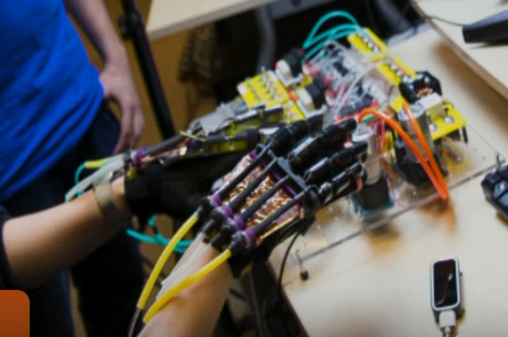
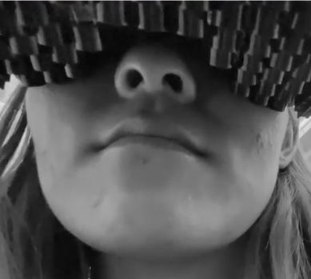
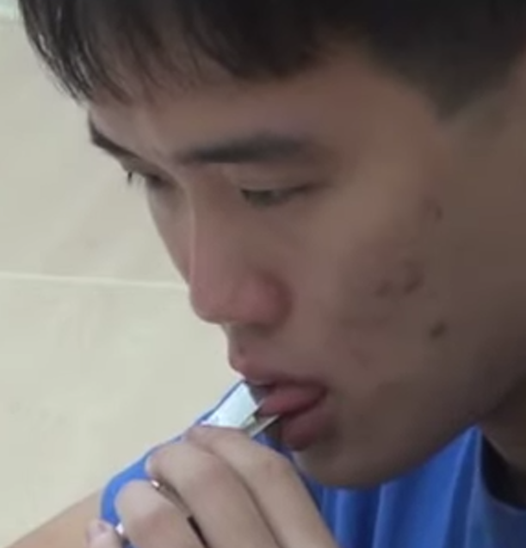
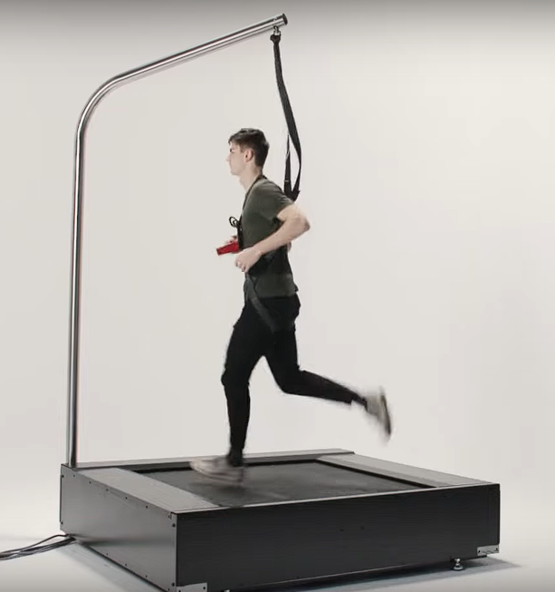
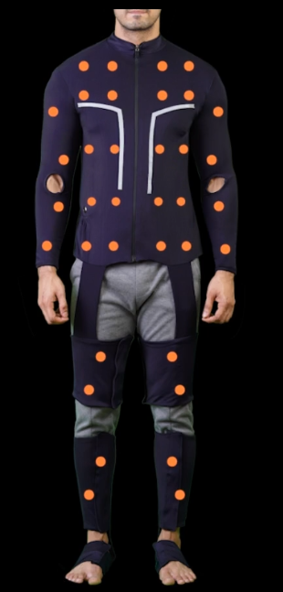
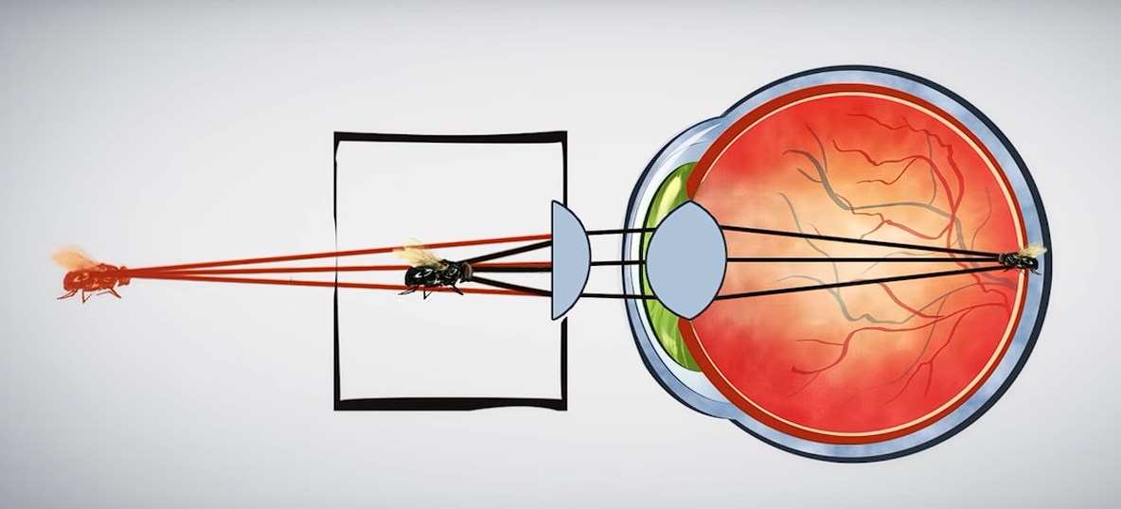
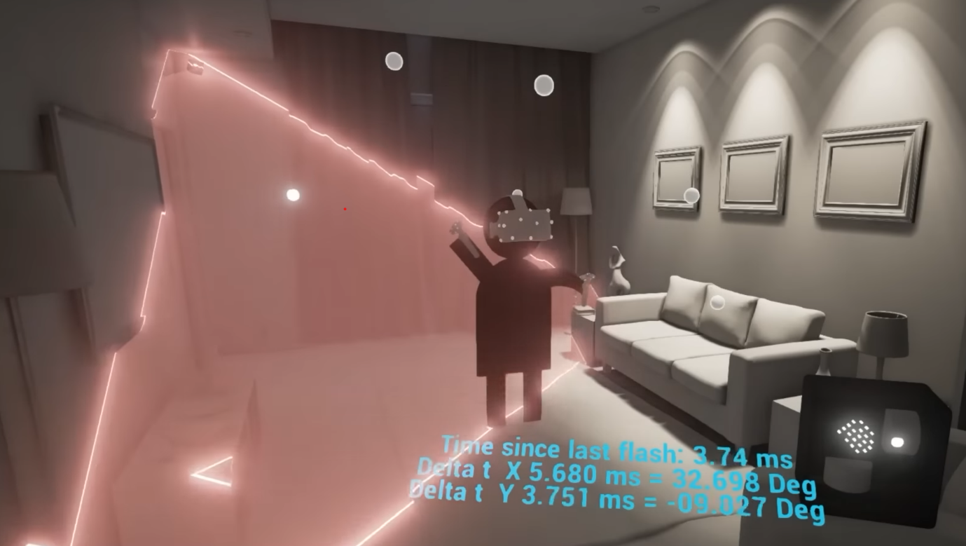
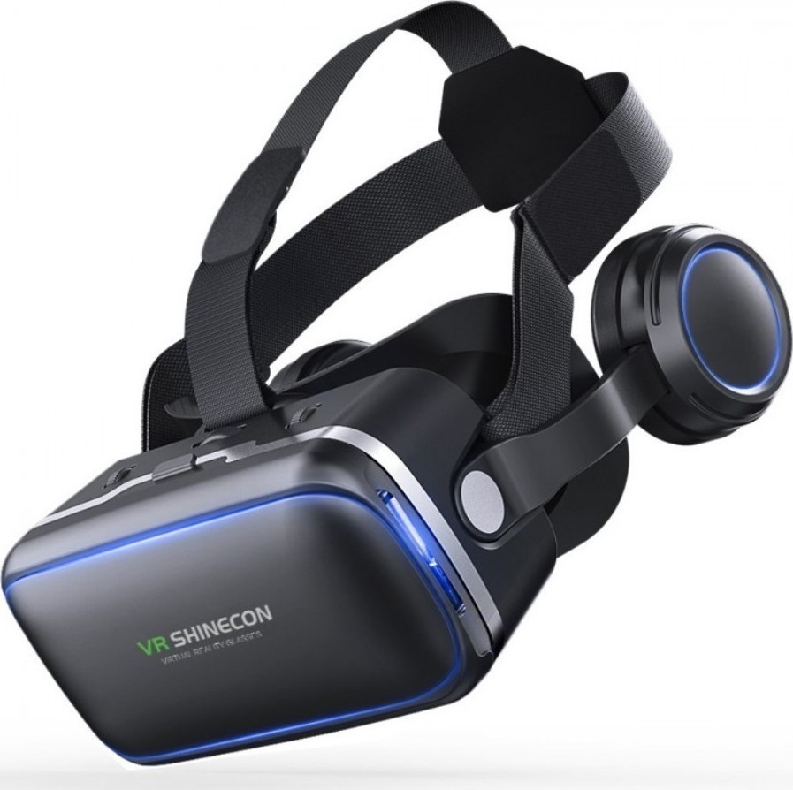
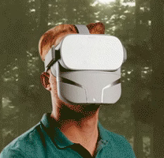
Emulating Senses in VR
Touch
Taste
Motion(6th sense)
Sight
Ultrasonic transducers form beams rendering haptic effects in the mouth
Electrical current and changes of temperature = basic tastes
Lenses help with focus
tiny speakers /haptic motors send vibrations on the skin.
Hearing
Integrated to headset
or
separate
Smell
Wind Fire Rain
F.B.T.( Full Body Tracking)
Lighthouse vs I.M.U.
Omnidirectional treadmills
Haptic/tracking suits
Feelreal

Slide 3
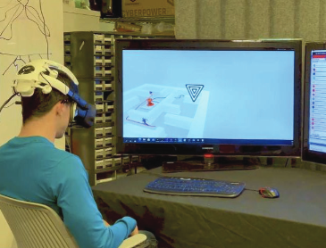
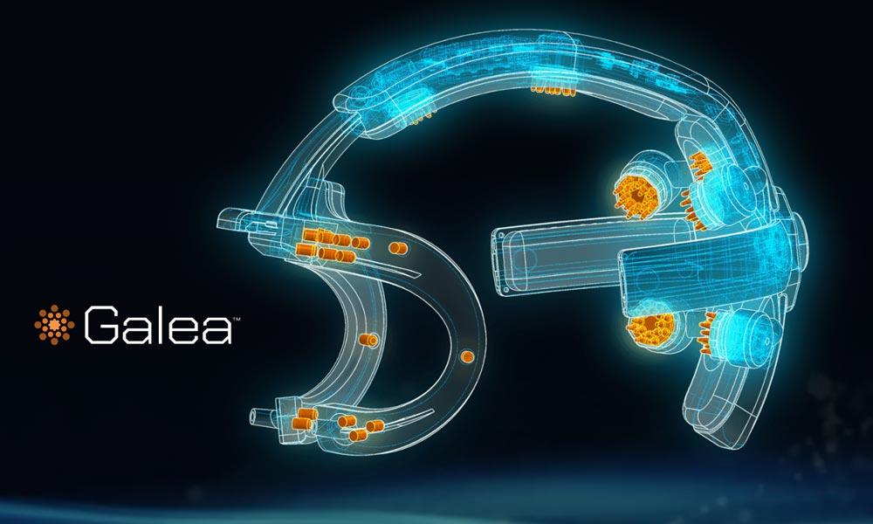
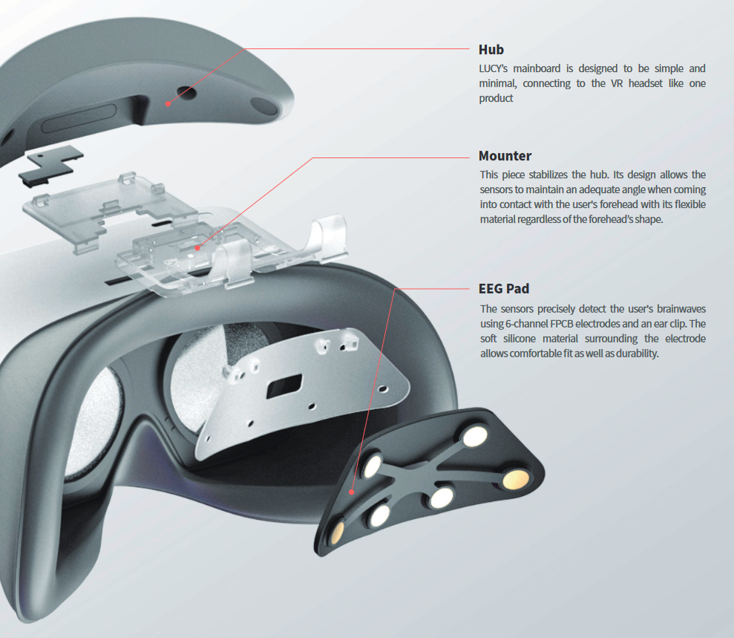
Lucy & Galea
Galea processes multimodal signals and measures the physiological response of the person experiencing VR content.
1.(Electroencephalogram, EEG) brain activity
2.(Electromyogram, EMG) muscles
3.(Electrooculogram, EOG) eyes
4.(ElectroDermal Activity, EDA)
electrical conductance of the skin as an immediate outcome of sweat secretion.
The SSVEP (steady-state visually evoked potential) game mechanics work by utilizing the user’s voluntary engagement to look at checkerboard patterns all over the maze flickering at different frequencies.
LUCY helps elderly people monitor their mental wellbeing and prevent decline through a set of games/activities. Six EEG sensors to measure the prefrontal lobe’s brain waves which are closely related to cognitive abilities such as information collection and judgment.

Slide 4
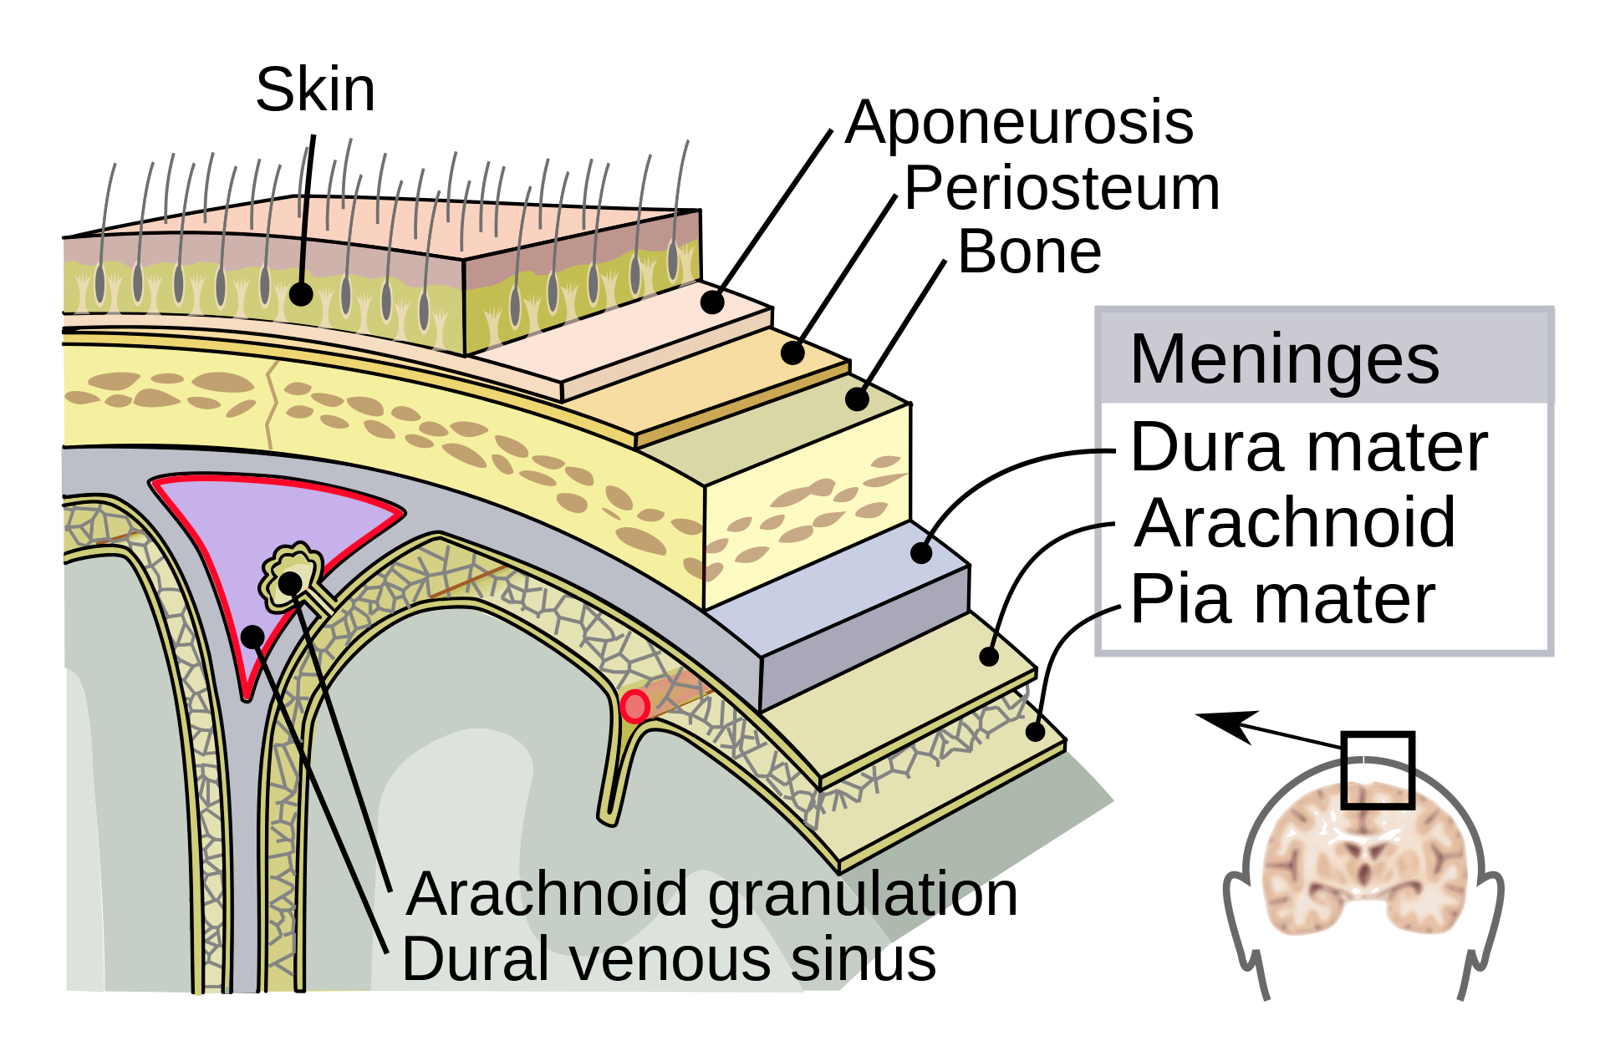
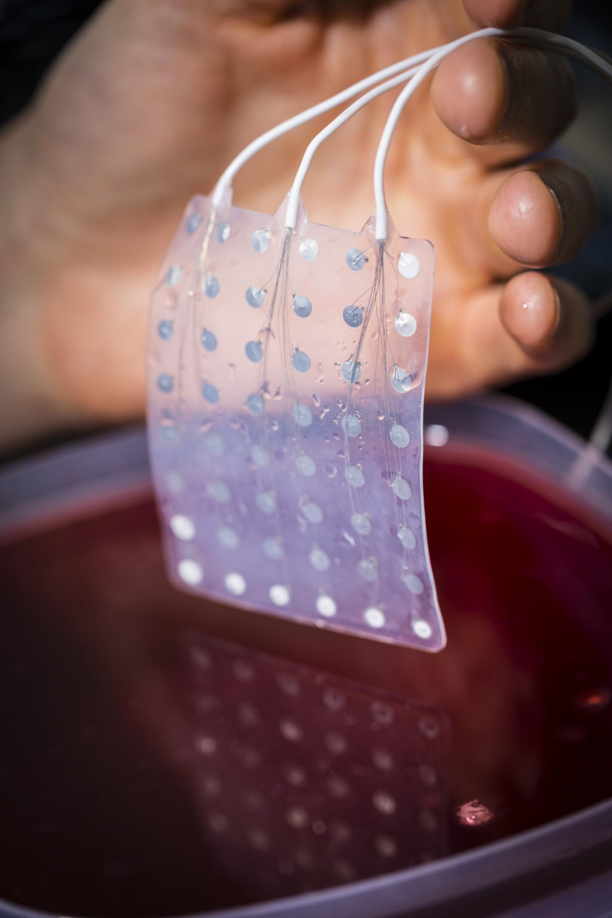
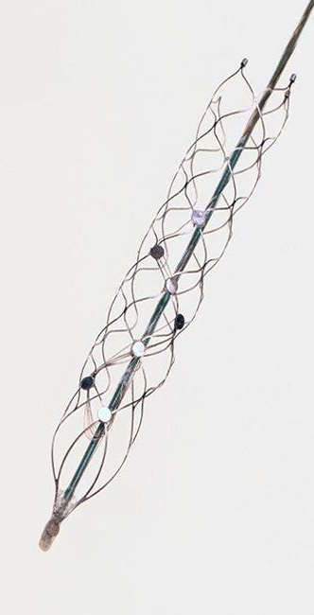

Partially invasive BCI
Endovascular - Strenode
A cylindrical mesh of electrodes inside the walls of veins gets delivered through an intravenous catheter being guided along the way, by image feedback from a fluoroscope, to the superior sagittal sinus which is a midline vein that drains many cerebral structures surrounding it and neighbors the motor cortex. This proximity enables the electrodes and the sensors to measure neural activity.
ECoG
Electrocorticography succeeds in acquiring brain electrical activity data by using electrodes embedded in a thin plastic pad that is placed above the cortex and below the dura mater.
ECoG has higher spatial resolution, better signal-to-noise ratio, wider frequency range, and less training requirements than scalp - recorded EEG, but also simultaneously it has lower technical difficulty and lower clinical risk.
“Space Invaders”
1. It is safer compared to brain implants.
2. Has enabled 5 people with amyotrophic lateral sclerosis and primary lateral sclerosis to wirelessly control an operating system via which they could text, email, shop, and bank using direct thought.

Slide 5
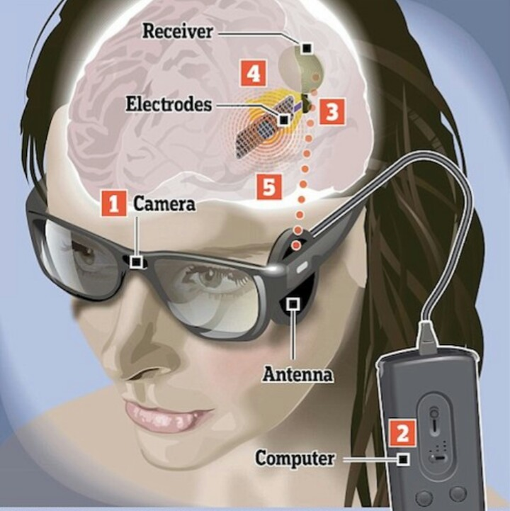
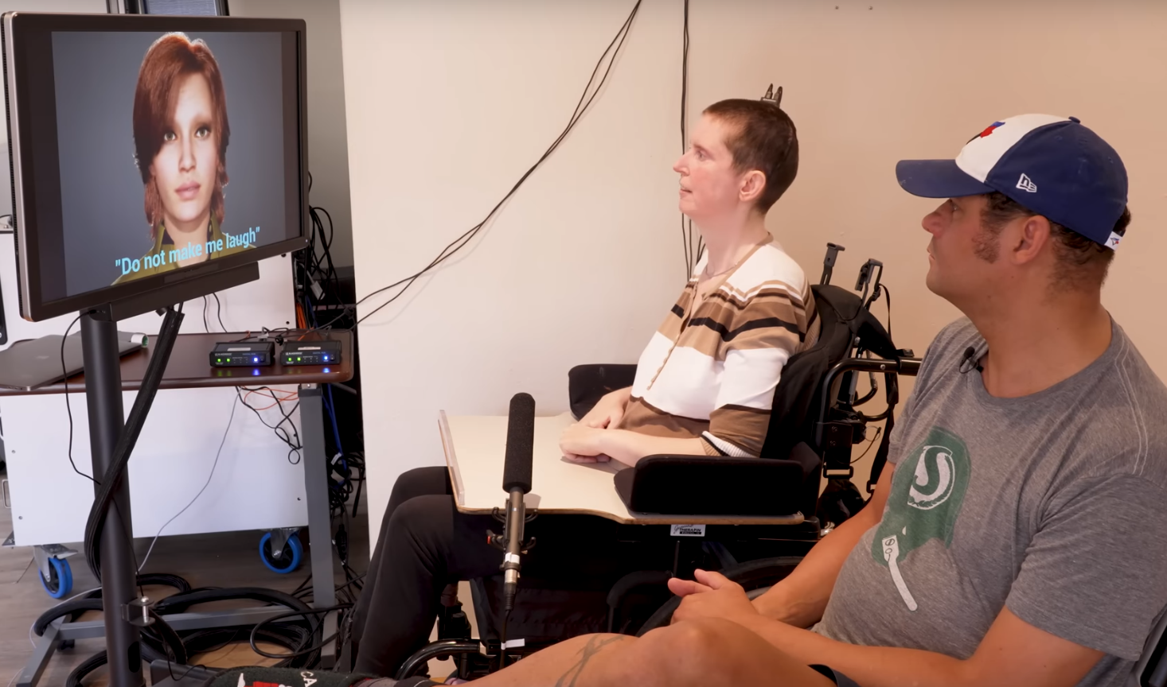
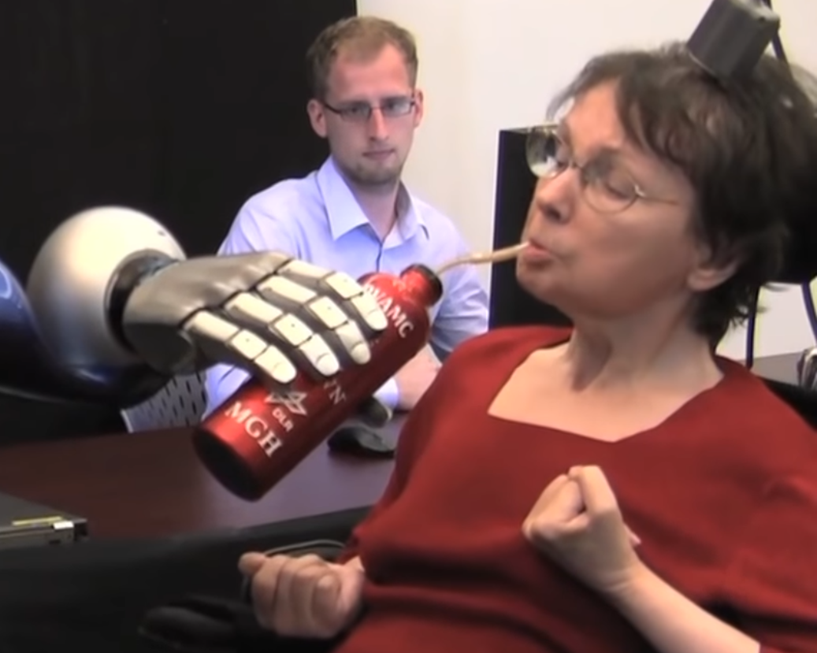
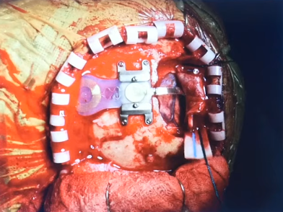
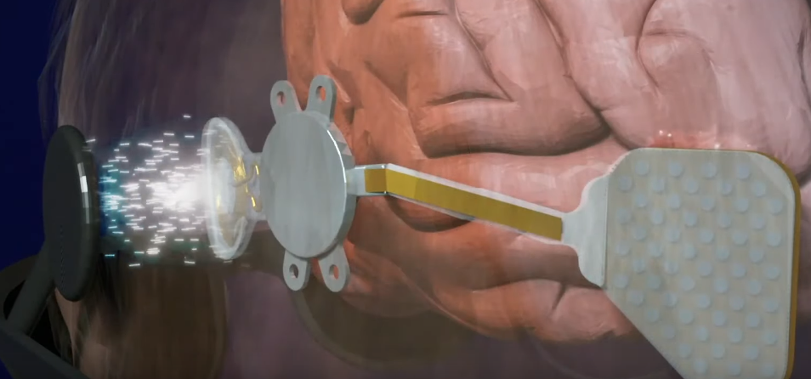
Invasive BCI
Voice restoration
The device is picking up the neural activity related to moving facial muscles and turns that into speech. These signals are acquired from a high-density electrocorticography (ECoG) array implanted over the sensorimotor cortex.
Predicts words utilizing deep learning models based on neural data.
Capable of reaching 78 words per minute.
Orion
Bypasses the injured eye’s anatomy transmitting electrical impulses directly to an array of electrodes implanted on the brain’s visual cortex.
5/5 people Able to locate a white square of a dark computer screen.
4/5 people being able to better identify the direction of motion of a bar moving across the screen.
Documented seizure.
BrainGate
Deciphers signals, via a 96-electrode sensor, coming from a brain implant located at the right precentral gyrus which is anatomically the area of the motor cortex responsible for arm movement.

Slide 6
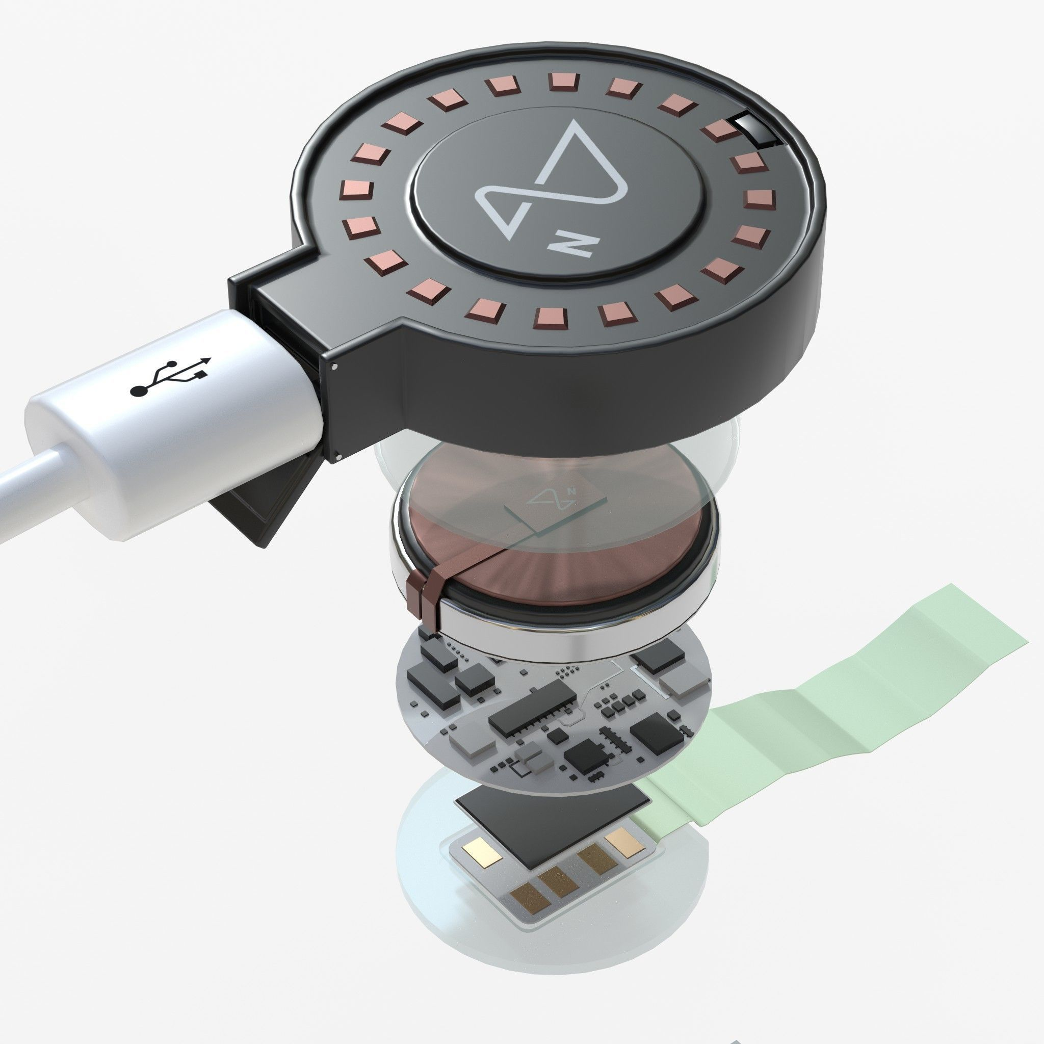

Neuralink & The future of BCI and VR
Not something new…
Focus
Novelties
Generalized versatile and applicable to a broad range of conditions or disabilities
Discrete design, no external cables or computation devices (computational device = smartphone).
Now: Patients with quadriplegia and the ability to operate their computers with their thoughts
Future: Restoration of capabilities such as vision, motor function, and speech.
Version 1: 1,024 electrodes
Version 2: 16,000 electrodes
Step 1
Safe, routine operations with the ability to emulate the biological senses adequately tested on disabled individuals.
Step2
Integration to society to improve our productivity and advance our scope of capabilities.

Slide 7
Thank you for your attention! Ü
Do you have any questions?

